Slide 1

Predicting loan default using machine learning

Slide 2
What are we solving?
In modern financial services, default risk prediction is the key. However, the credit evaluation relying on manual rules cannot process complex customer portraits in real time:
Relying on static models, unable to dynamically adapt to market changes, and difficult to identify high-risk customers
It is difficult to assess the risk, resulting in the mismatch between income and risk
The project aims to build an automatic and real-time machine learning system to predict whether customers default.

Slide 3
Why does it matter?
Banks need to optimize credit structure, identify default customers in advance and reduce bad debts
Improve customer layering and approval efficiency
Realize risk sensitivity assessment and default prediction
Avoid business losses and enhance regulatory reliability

Slide 4
What can we do to achieve this?
We extract customer information from multiple dimensions:
Income, liabilities, occupation ,living conditionsLoan amount, annuity, credit query recordPhone/address matching, application submission timeHistorical default records, external scoring sources
Through these structured data, the machine learning model is constructed to realize the automatic determination of risk level.

Slide 5
How did we achieve this?
This is a typical supervised classification problem. We adopt the following methods:
Data preprocessing (missing padding, hot coding, normalization)
Characteristic Engineering (scoring source, property age, telephone change days)
Modeling algorithms include:
Logistic regression (benchmark model)
Random forest
Multi layer perceptron (MLP)
The data was divided into five fold cross validation, and the evaluation indicators included AUC, F1, recall, etc.

Slide 6
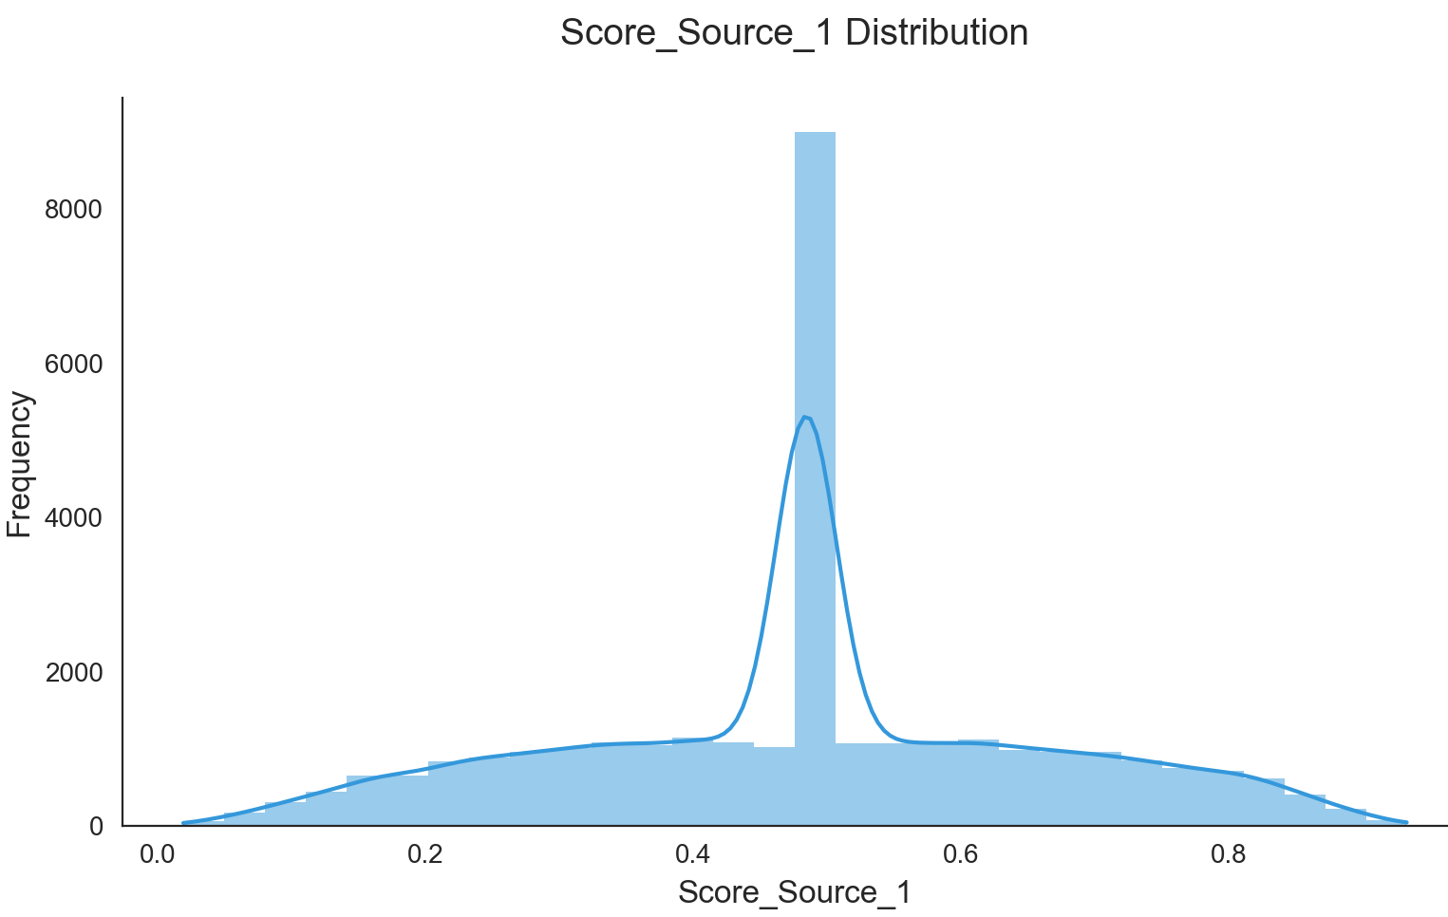
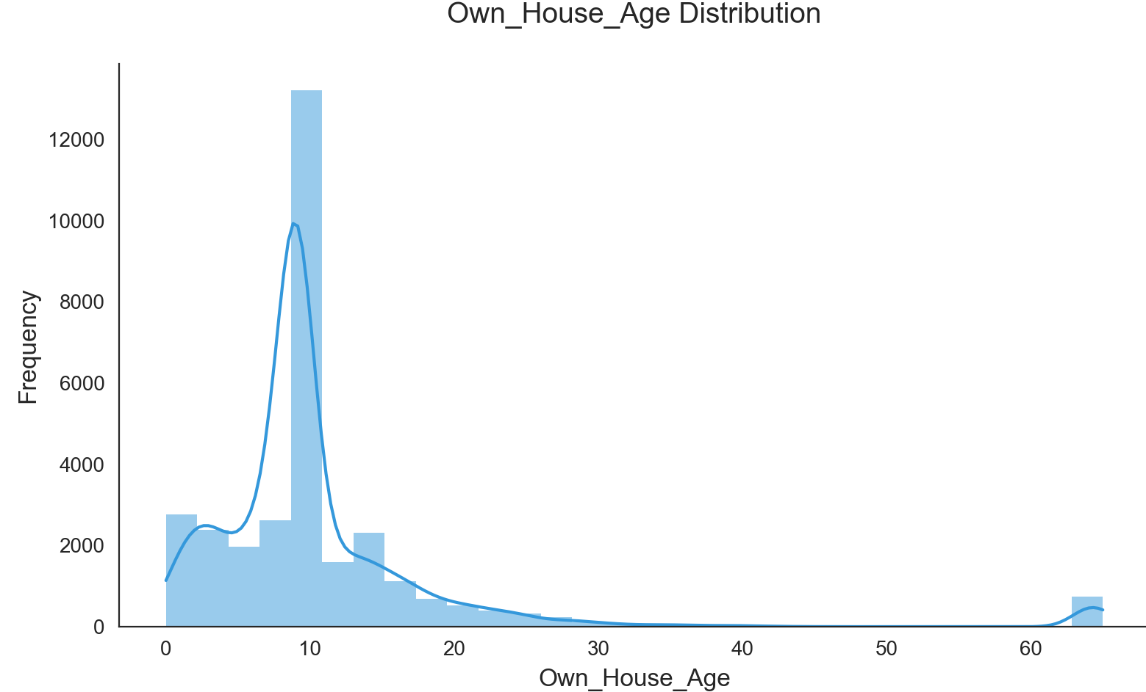
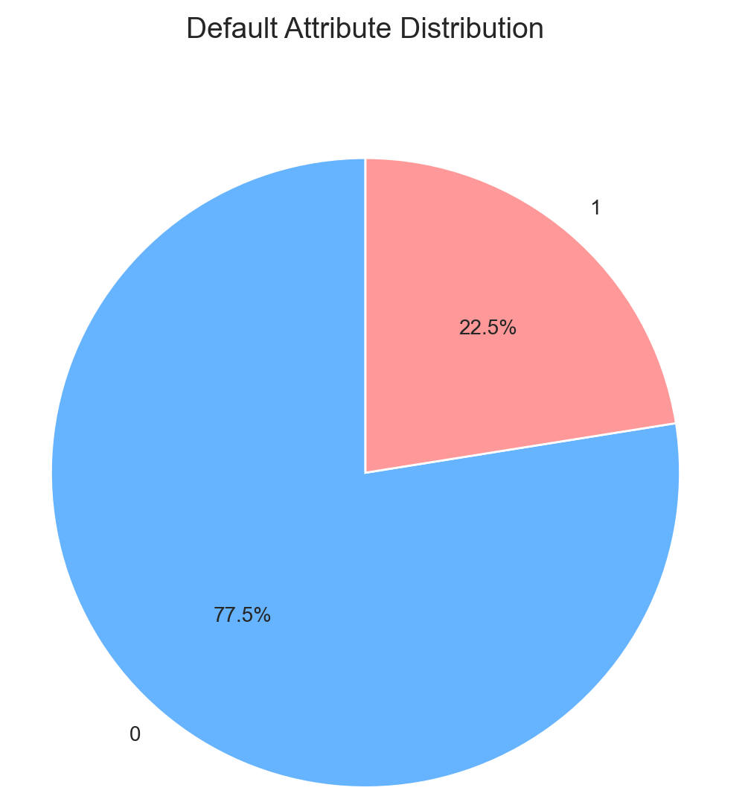
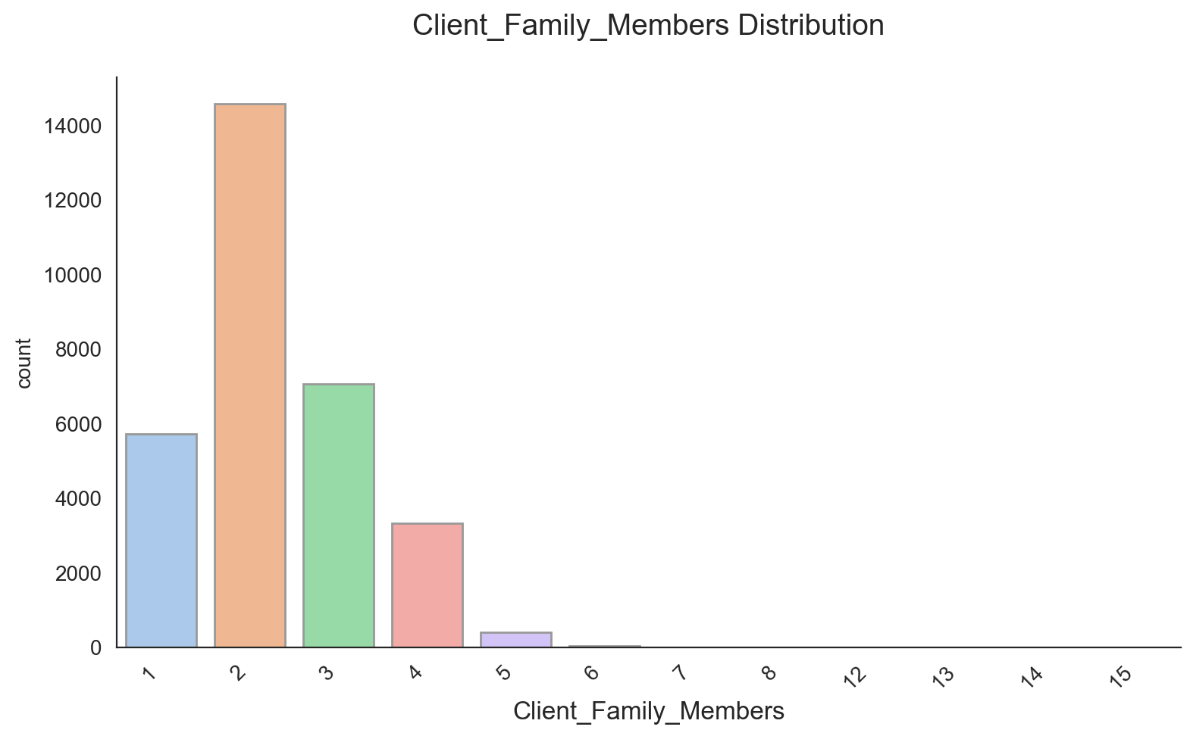
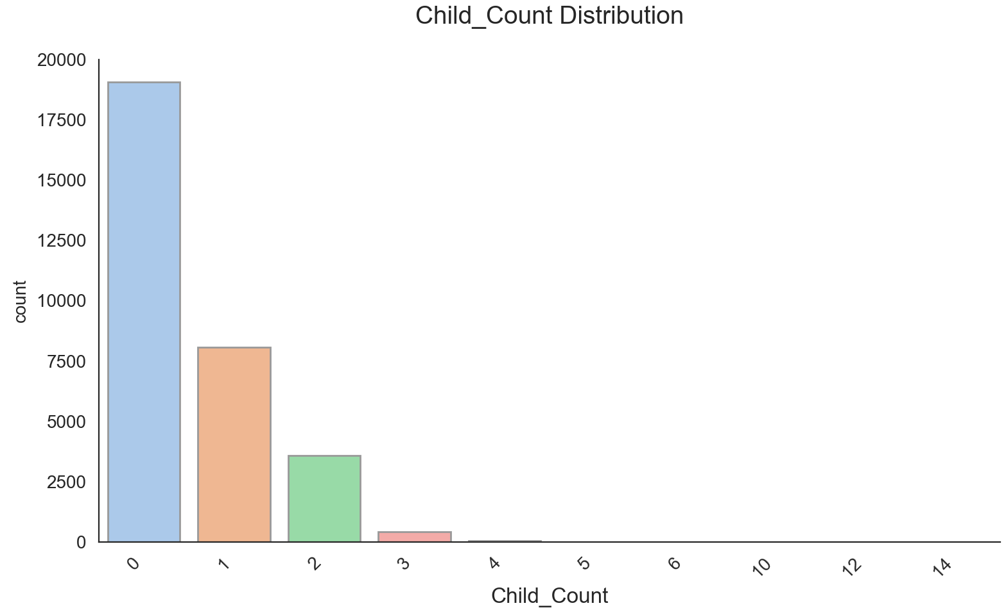
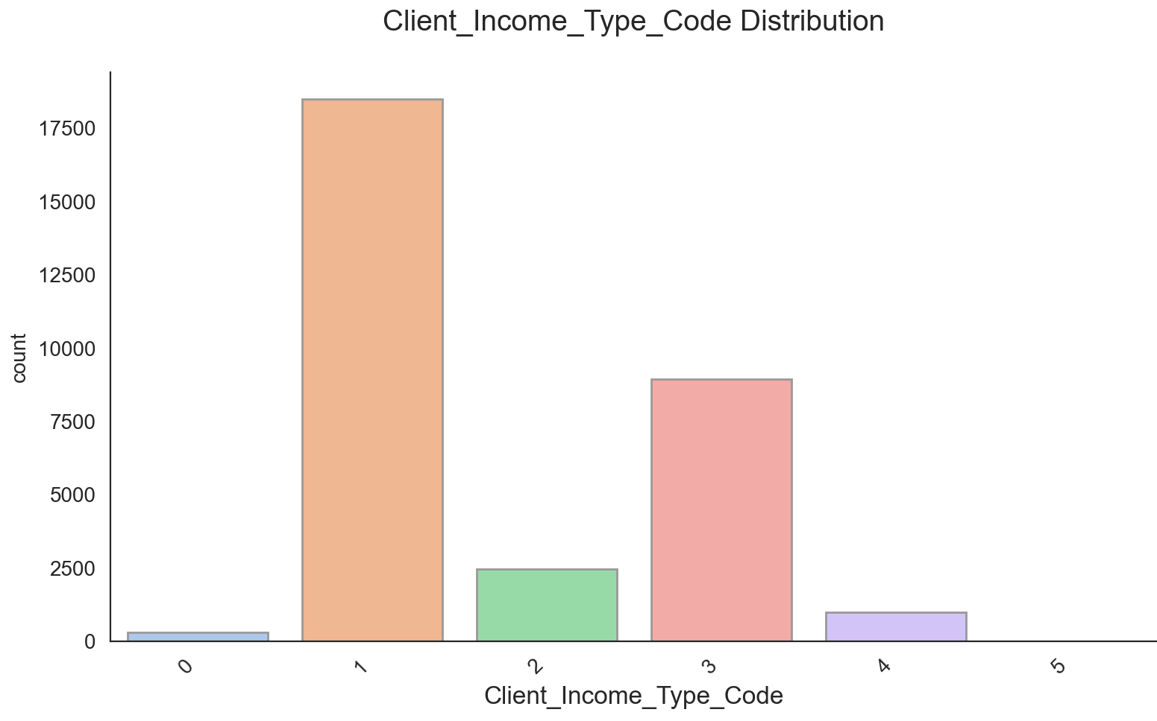
Data insight (partial)

Slide 7
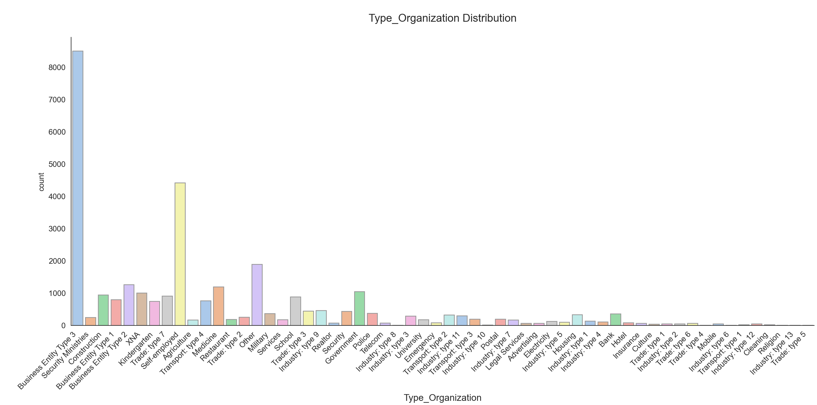
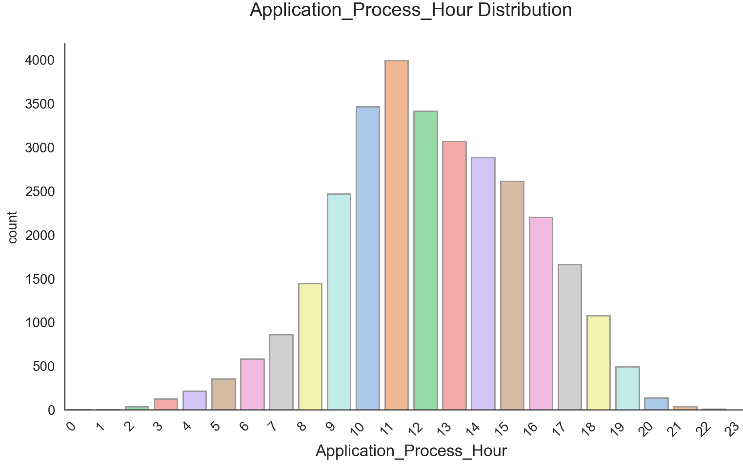
Data insight (partial)

Slide 8
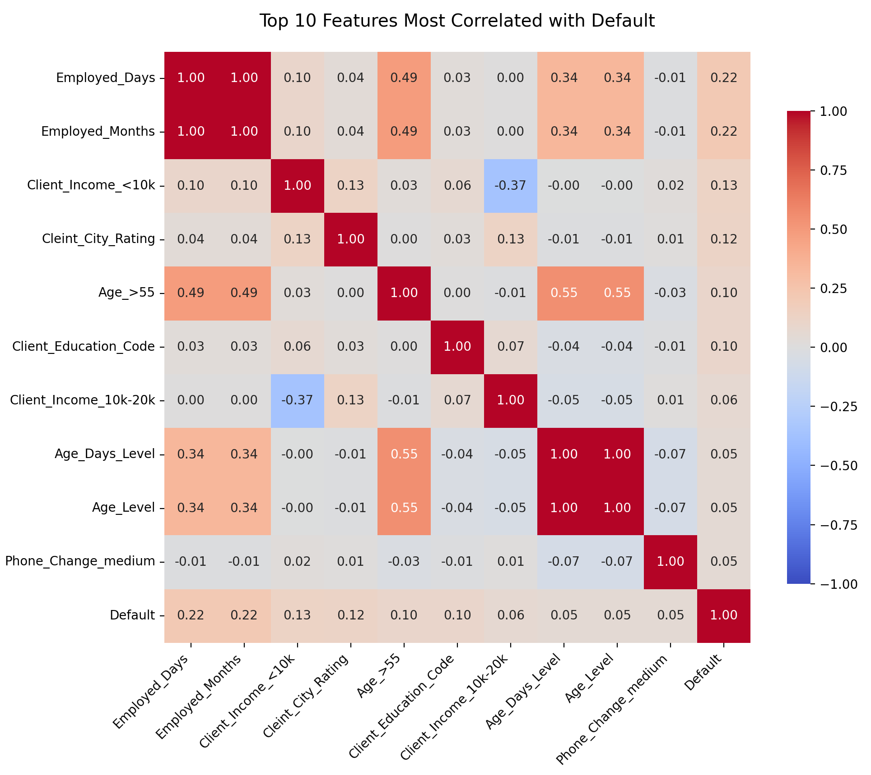
Feature Correlation Heatmap
Identify key factors influencing loan default risk through correlation analysis.
Key Insights
Employed_Days and Employed_Months show strong negative correlation with default risk.Interpretation: Longer employment reduces likelihood of default.
Income & Age Play Significant Roles
Lower income (<10k) correlates positively with default (higher risk).
Older applicants (Age_>55) show lower risk, likely due to financial stability.
Weak Predictors: Phone_Change_medium and Client_Education_Code have minimal impact.

Slide 9
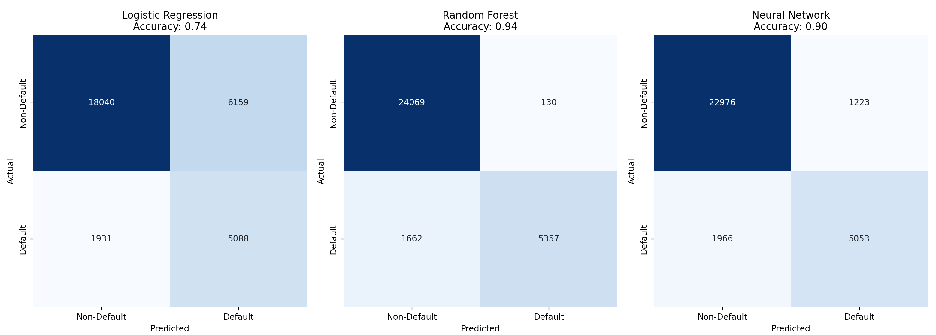
What was our outcome?
Training Evaluation (Nested Cross-Validation)
The three models show the following performance on the training set:
Model | Accuracy | F1 (Macro) | Precision | Recall | AUC-ROC
Logistic Regression | 0.7409 | 0.6870 | 0.6778 | 0.7352 | 0.7352
Random Forest | 0.9426 | 0.9104 | 0.9559 | 0.8789 | 0.8789
Neural Network | 0.8821 | 0.8305 | 0.8312 | 0.8298 | 0.8298
Random Forest achieved the highest overall performance during training, outperforming others in all metrics.

Slide 10
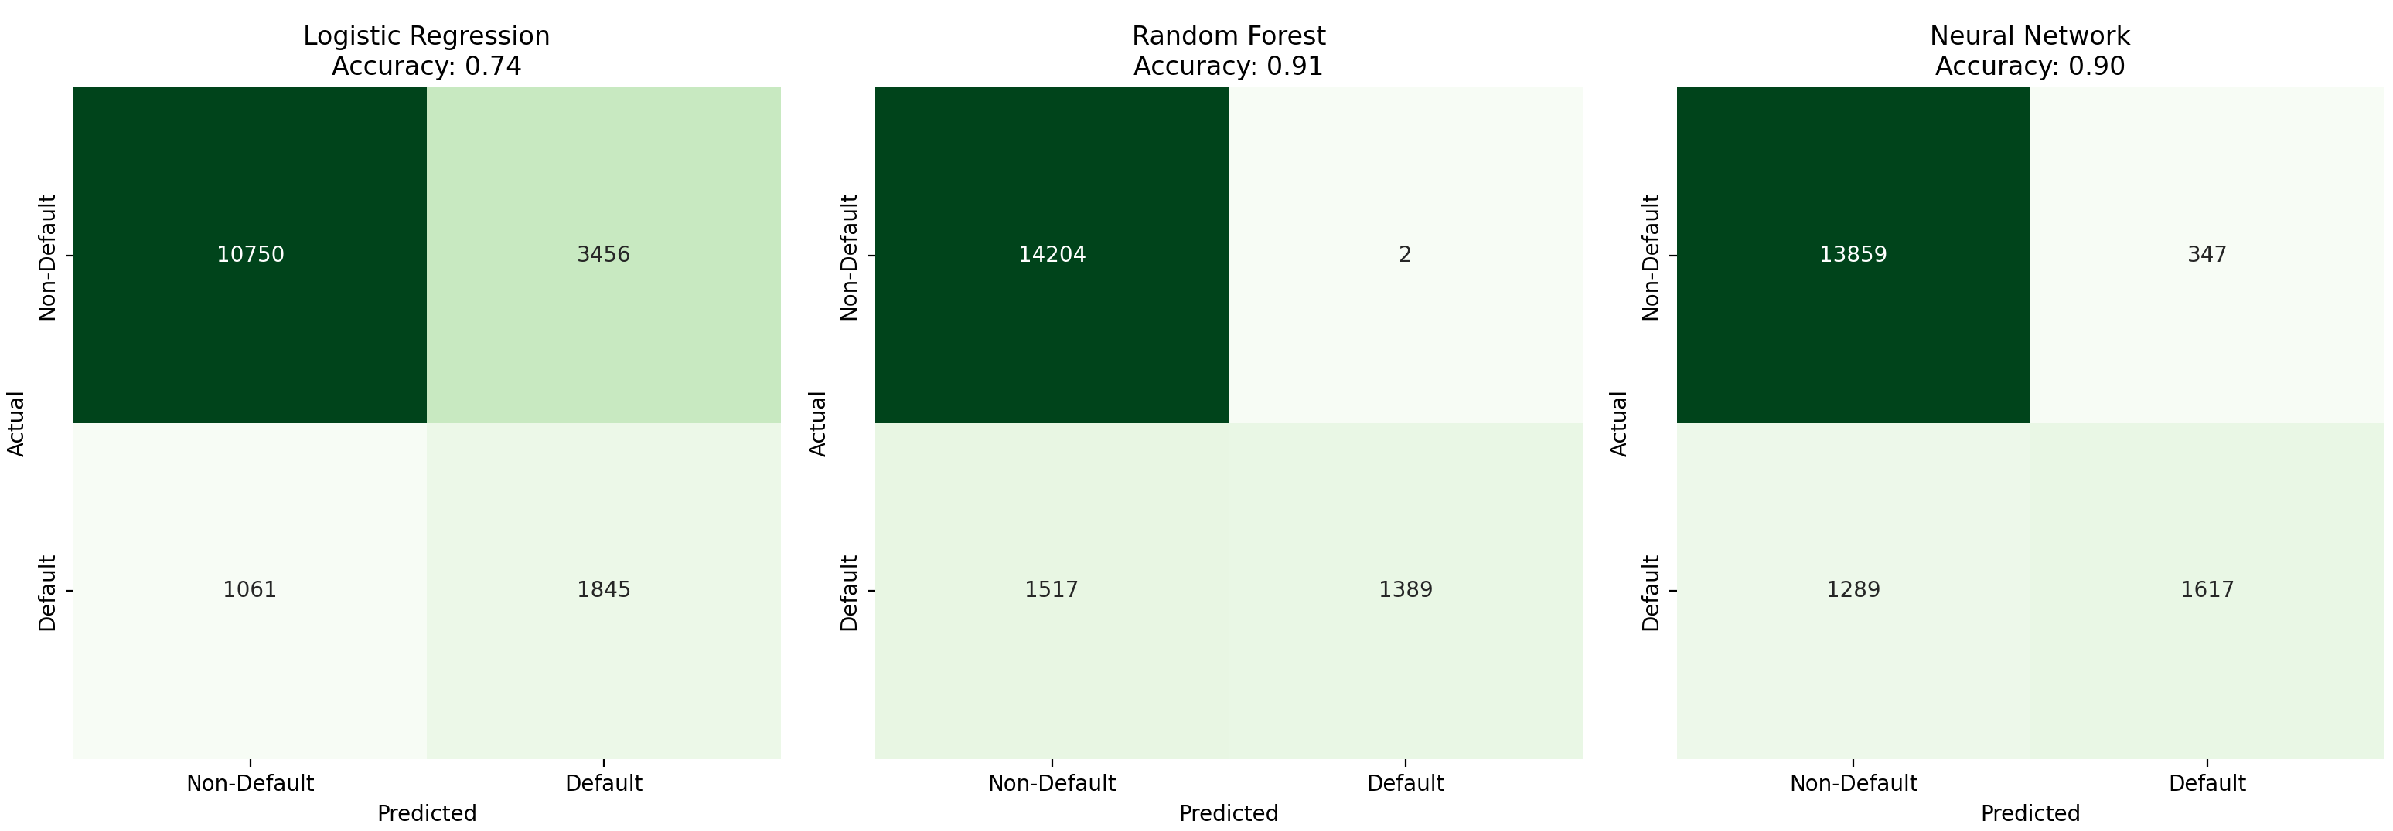
What was our outcome?
Test Evaluation
On the test set, the generalization
performance is as follows:
Model | Accuracy | F1 (Macro) | Precision | Recall | AUC-ROC
Logistic Regression | 0.7360 | 0.6380 | 0.6291 | 0.6958 | 0.6958
Random Forest | 0.9112 | 0.7979 | 0.9510 | 0.7389 | 0.7389
Neural Network | 0.8891 | 0.7838 | 0.8185 | 0.7594 | 0.7594
Random Forest maintains the highest accuracy and precision, while the Neural Network offers the best balance between F1 and recall, making it more suitable when identifying defaulters is critical.

Slide 11
Summary
This project focuses on predicting loan default using machine learning. By analyzing customer demographics, financial status, and application data, we built models to assess credit risk.
Goal: Accurately classify borrowers to reduce defaults and support automated credit decisions.
Method: Data preprocessing and feature selection; Trained Logistic Regression, Random Forest, and Neural Network; Used nested cross-validation and tested on unseen data
Results: Random Forest achieved top accuracy and precision;Neural Network offered strong recall and balanced performance;Logistic Regression was used as a baseline
Value: Improved risk prediction, reduced credit losses, and enabled scalable, data-driven loan assessment.

